Slide 1



2027 Open Enrollment
Overview

Slide 2
Open Enrollment Overview
Open Enrollment Dates:
October 23rd through November 6th!
Make selections through the Cummins Health Benefit Service Center or contact the Cummins Health Benefits Service Center at 1-877-377-4357
____________________________________________________________________________
IMPORTANT: If you do not make changes to your current benefits during Open Enrollment, by default, you will be enrolled in the same plan that you had in 2026.
You must enroll in an FSA each year as this will not automatically roll over during Open Enrollment.
HSA selection will automatically rollover for 2027 at the deduction limit that you have set in 2026. You may increase or decrease this limit at anytime throughout the year!
____________________________________________________________________________

Slide 3
Open Enrollment Overview
Learn more about your choices!
Medical ― Covers medical services and prescriptions and includes access to vision coverage and resources to help you get the care you need. You have several options available, including the PPO Plan, and two updated HSA-compatible plans ― the HSA Plan and HSA Plus Plan. This year, your employee contributions will be in line with your pay.
Dental ― Covers a broad range of dental services, including preventive care, basic services, major services and orthodontia. New this year, you can choose to use Cummins’ Limited Purpose Health Care FSA to help pay for eligible dental expenses.
Supplemental medical benefits – Voya Provides optional coverage you can elect to ensure additional protection in case of specific medical events like an accident; hospital stay; or diagnosis of a critical illness.
Health Savings Account (HSA) ― Offers an opportunity to save tax-free for your qualified health care expenses if you enroll in the HSA Plan or HSA Plus Plan. Think of your HSA as a “savings account.” You can use the money in your account to help pay for care now or grow your account for your future health care needs.
Flexible Spending Accounts (FSAs) including the Limited Purpose Health Care FSA* ― Provides opportunities to save on taxes by paying yourself back for eligible health care and/or dependent care expenses with tax-free dollars, including the new Limited Purpose Health Care FSA that you can use to pay for eligible dental and vision expenses, *if you are enrolled in an HSA Plan. Due to IRS requirements, you will lose any amounts you contribute but don’t use during the year.
Optional life and AD&D Insurance ― Optional life and AD&D insurance offers financial benefits in case of serious injury or death and are in addition to your employer-provided coverage. Optional coverage is also available for spouses/domestic partners and dependent children.
MetLife Legal Plan - affordable access to experienced attorneys for you, your spouse, and dependents
ID Watchdog - insurance which provides tools to monitor your credit and protect you from identity theft and fraud.

Slide 4
Open Enrollment Overview
Choosing your medical plan
Features important to you — Think about your preferences and what each plan has to offer. For example, are you interested in saving for future health care expenses tax free?
Your coverage needs — Consider how much medical care you typically use each year. Do you mostly just get preventive care (like annual physicals and screenings) or do you typically find yourself in the doctor’s office quite a few times a year, seeing specialists and/or managing a condition?
Your costs and budget — Don’t just focus on the employee contributions. Factor in all your costs, including what you might pay as you receive care throughout the year. Also consider how you prefer to pay (more upfront through higher employee contributions or more as you go if you need care) — and remember to think through the potential of an unexpected health care expense.
If you prefer lower contributions with higher out-of-pocket costs, consider the HSA Plan.
If you prefer a mid-range option for contributions and out-of-pocket costs, the HSA Plus Plan may be right for you. And, with the HSA Plus Plan, Cummins will contribute into your HSA to help boost your savings.
If you’d rather pay higher employee contributions and lower out-of-pocket costs at time of service, look into the PPO Plan to see if it’s the best fit for you.
If you’re not sure which plan to choose, check out the online decision support tool available during enrollment. This year’s enhanced plan uses your data to give you personalized recommendations and insights into what health plan could best fit your needs.

Slide 5
Health Care Plan Design
Medical
(EE/EE+) | HSA Plan | HSA Plus Plan | PPO
HSA Account funding | $0/$0 | $600/$1,200 | NA
Deductible | $5,000/$10,000 | $2,250/$4,500 | $750/$1,500
Plan coinsurance |  | 80% | 80%
Office visit (OV) PCP/SCP | 100% after deductible | 80% | $25/$40
Emergency room |  | 80% | $150
Out-of pocket maximum (incl. ded.) | $5,000/$10,000 | $4,500/$9,000 | $3,250/$6,500
If electing coverage for employee plus any dependents | Has $5,000 individual limit - meaning no single individual on a family plan will have to pay more then this amount for eligible in- network services in the plan year. | The deductible and OOPM are a family amount - meaning everyone covered contributes to a collective amount. There is a OOPM individual limit of $7,500. | Has an individual limit of $750 for the deductible and $3,250 for the OOPM - meaning no single individual on a family plan will have to pay more then this amount for eligible in-network services in the plan year.
No changes for 2027

Slide 6
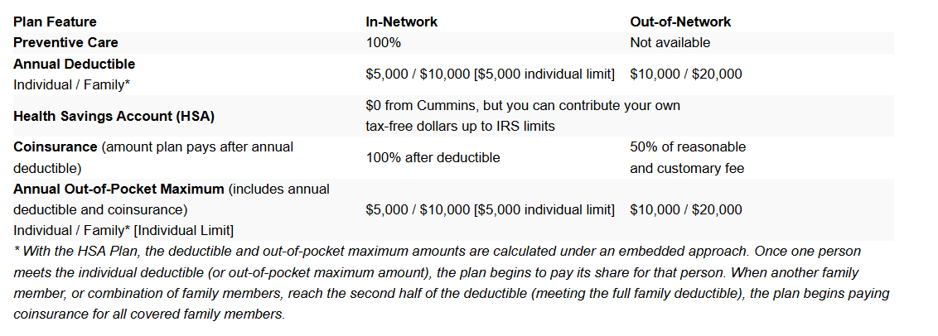
2027 HSA Plan

Slide 7
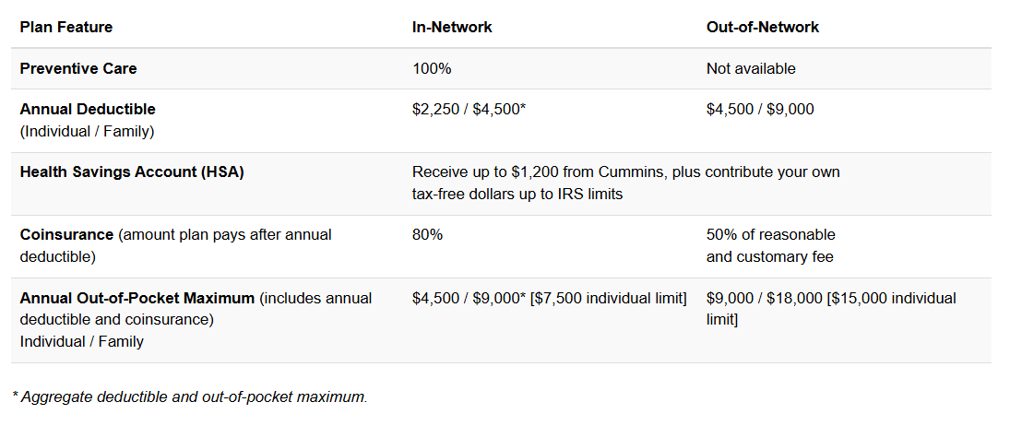
2027 HSA Plus Plan
If you elect the HSA Plus Plan, Cummins will contribute $600 for Employee only coverage and $1,200 for all other coverage levels. If you are not eligible to contribute to an HSA, Cummins will contribute to a Health Reimbursement Arrangement (HRA) instead.

Slide 8
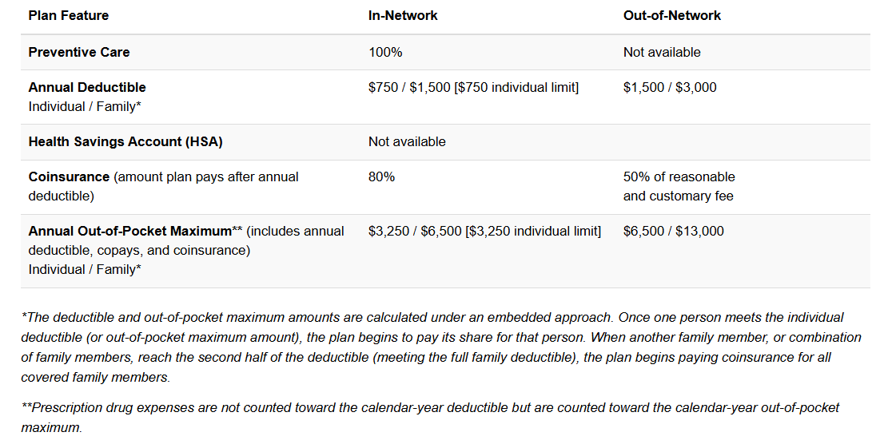
2027 PPO Plan

Slide 9







2027 Open Enrollment – Updates/Changes
Medical
Company and employee contributions for 2027 reflect rising healthcare costs.
Infertility benefits
Lifetime maximum increasing to $40,000.
Prescriptions
Pharmacy benefit manager changing to Judi Rx.
Dental
Annual maximum increasing to $2,500, with orthodontic coverage for employees extended from age 23 to age 26.
Vision
Frame/contact allowance increasing to $200.
Life insurance
3x annual base salary coverage now available up to $600,000, allowing an increase in coverage without Evidence of Insurability (EOI).
LearnLux
A financial wellbeing platform that provides employees with personalized financial education, planning tools, and access to professional financial planners.

Slide 10

Pharmacy Change
Improved Employee Experience & Transparency
Supports Long-Term Healthcare Affordability
Broad Pharmacy Access Will Continue
Seamless Transition for Members
Judi Rx was selected to provide a more transparent, employee-focused pharmacy experience with strong member support and advocacy, including a dedicated phone number and microsite for questions, drug costs and in-network pharmacies.
The change is part of Cummins' broader healthcare optimization strategy to manage rising pharmacy costs while maintaining competitive, sustainable benefits for employees
Employees will continue to have access to a nationwide network of more than 60,000 pharmacies, with most members expected to maintain access to their current pharmacy.
Existing prescriptions and prior authorizations will continue through normal processes, minimizing disruption for employees and their families during the transition.

Slide 11
Pharmacy Change
Prescriptions: Judi Rx is your new vendor
Beginning January 1, 2027, prescription drug benefits will transition from Express Scripts to Judi Rx. Coverage and features will remain the same, with Judi Rx providing access to a broad pharmacy network, support resources and cost-saving programs.
What you need to know:
Active prescriptions will transfer automatically: No action needed.
Coverage and features will remain the same: There are no changes to copays, deductibles and out-of-pocket maximums.
Pharmacy choice: You can continue using CVS, Walmart, Walgreens or other pharmacies within Judi Rx’s large pharmacy network.
Mail order: Current mail order prescriptions will transfer automatically in early January. You can choose to receive a 90-day supply via mail order or a 30-day supply filled at an in-network retail pharmacy.
Medication coverage changes: If your medication moves from a preferred drug to a non-preferred drug, or is no longer covered, Judi Rx will notify you in writing of alternatives and next steps.
Cost-saving programs: Judi Rx offers tools to help lower medication costs. If Judi Rx contacts you, they may be reaching out to help you understand potential savings opportunities and your options.
Visit the Judi Rx microsite to learn more about your 2027 prescription benefits, explore pharmacy options, review coverage details, and access helpful resources and FAQs about the transition to Judi Rx.

Slide 12
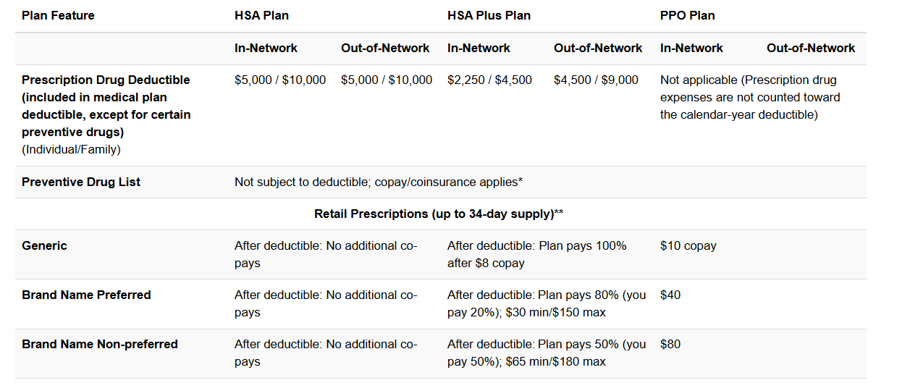
Prescription Drugs

Slide 13
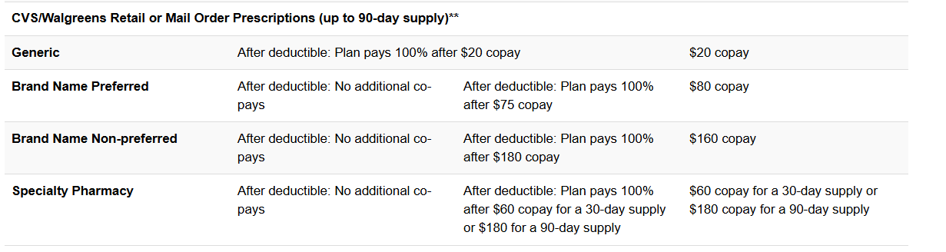
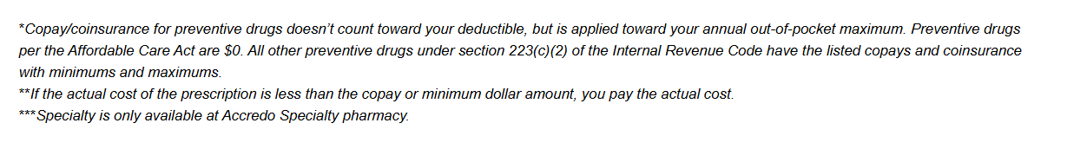
Prescription Drugs Continued

Slide 14
Health Care Plan Design
2027 Pharmacy
2027 | HSA Plan | HSA Plus Plan | PPO
Deductible (EE/EE+) | Combined with medical | Combined with medical | NA
Out-of-pocket maximum (EE/EE+) | Combined with medical | Combined with medical | Combined with medical
Generic (min/max) |  | $8 | $10
Formulary (min/max) | 100% after deductible | 80% ($30 min, $150 max) | $40
Nonformulary (min/max) |  | 50% ($65 min, $180 max) | $80
No changes for 2027

Slide 15
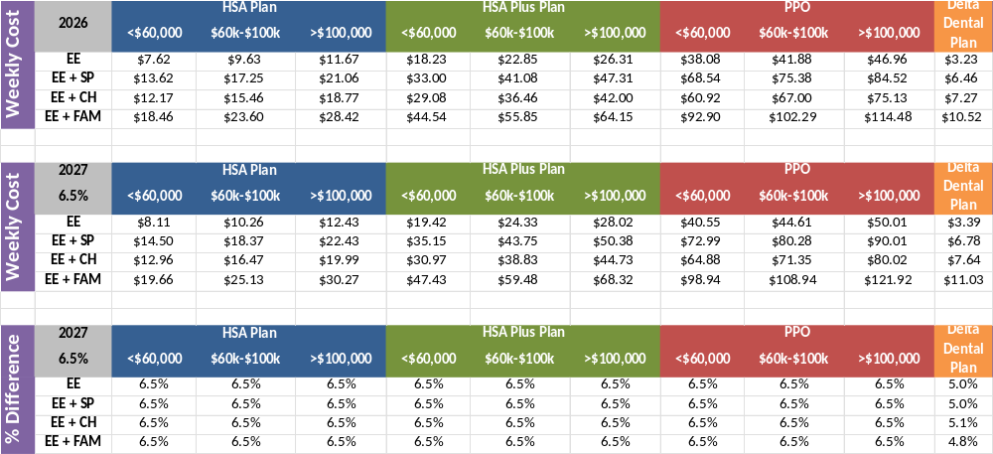
Employee Contribution
Medical & Dental OCU Weekly Contribution & Percentage Comparison

