Slide 1
OCU Apprenticeship Program Overview
Date: 8/18/2023

Slide 2
What is the Apprenticeship Program?
Program for developing an employee for a Cummins Level 4, “Technician” role
Governed by the Department Of Labor & Cummins Joint Apprentice Committee (JAC)
Rules and guidelines of the program are defined in the Cummins “Apprenticeship Standards” document
  Policy which is an addendum to the Base Business Labor Agreement
Successful Graduates receive a certificate of completion from the Department of Labor and become Department of Labor Journeyman Technicians
  College credits apply towards a degree in the appropriate field of study

Slide 3
Who is the JAC?
Joint Apprenticeship Committee consists of one Office Committee Union (OCU) and one Exempt representative for each technical trade, plus the chairperson, the administrator, and the Vice-President of the OCU
  OCU positions are nominated and selected by the OCU Executive Board
  Exempt and Chairperson positions are among interested parties in the relative fields with ties to the apprenticeship program
  The administrator is from the Global Recruiting department, and they track the apprentices’ progress throughout the program

Slide 4
OCU Apprenticeship Trades
Electrician (Maintenance)
Electronics Engineering
Experimental Machinist
Facilities Drafting
Facilities Maintenance
Instrumentation
Materials Engineering
Mechanical Engineering Drafting
Mechanical Engineering Technician
Software Engineering

Slide 5
Southern Indiana Locations
Apprentices may rotate to multiple locations in order to satisfy OJT requirements (list not all-inclusive)
  CTC (Cummins Technical Center)
  FSP (Fuel Systems Plant)
  STC (Seymour Technical Center, located in the SEP, Seymour Engine Plant)
  LDTC (Light Duty Technical Center, located in the CEP, Columbus Engine Plant)
  OLY (Olympia building in Walesboro)
  WTC (Walesboro Technical Center – also known as Noise Lab)
  PCN (Pilot Center North)
Gives employees the opportunity to experience locations without the commitment of bidding
Meet contacts/network opportunities

Slide 6
Apprentice Opportunities
What an Apprentice can do after graduation:
  Level 4 Technician
  Level 5 Engineering Associate
  Level 5 Trades Associate
Potential Improvements
  Early mentoring/recruiting
  Early & often opportunities
  Various educational paths to meet business needs

Slide 7
Apprenticeship Academics
Approximately 11-15 college courses defined by Cummins Joint Apprenticeship Committee (JAC)
Local education providers are:
  Columbus Purdue Polytechnic
  Ivy Tech Community College
  Indiana University / Purdue University of Columbus
  Vincennes University
Opportunity for employee to receive credit for completion of previous academics completed from other colleges and universities

Slide 8
Apprenticeship OJT
On the Job Training (OJT)
8000 hours (4 years) work experience
Hours worked at Cummins becomes part of the required OJT
Opportunity for an employee to receive credit for completion of previous work-related experience - maximum allowable credit is 6000 hours

Slide 9
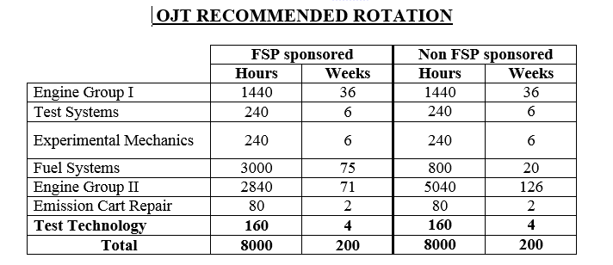
On The Job Training Example
All apprentices are required to rotate throughout different teams in order to satisfy OJT requirements
OJT and Academic requirements differ between each apprenticeship trade
The OJT and Academic examples listed below are exclusively for the Mechanical Engineering Technician Apprenticeship
OJT EXAMPLE

Slide 10
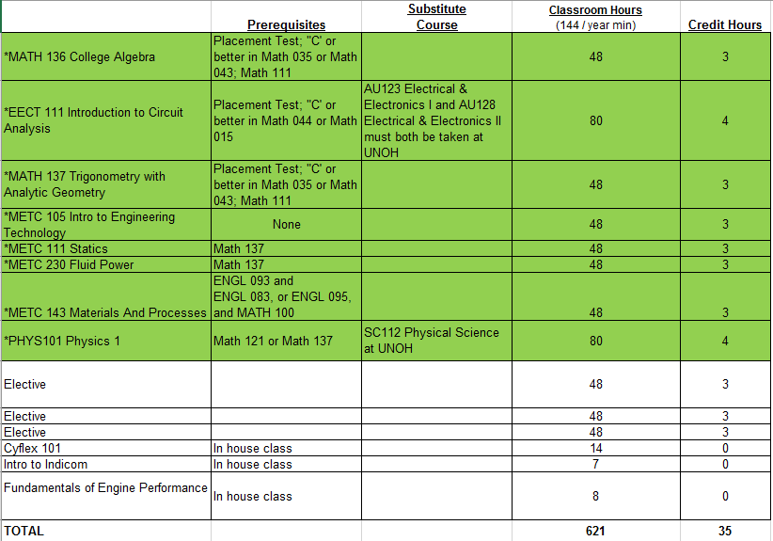
Classroom Training
ACADEMIC EXAMPLE

Slide 11
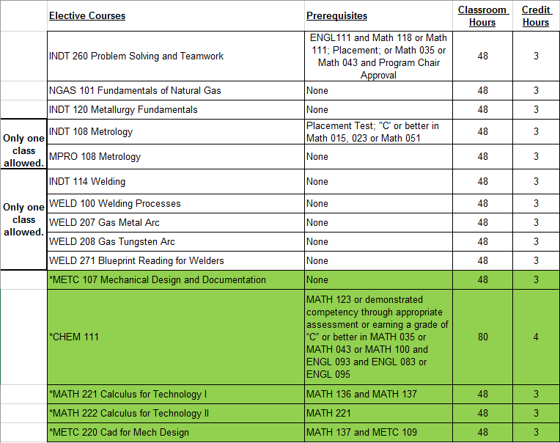
Electives
ACADEMIC EXAMPLE

Slide 12



